Slide 1
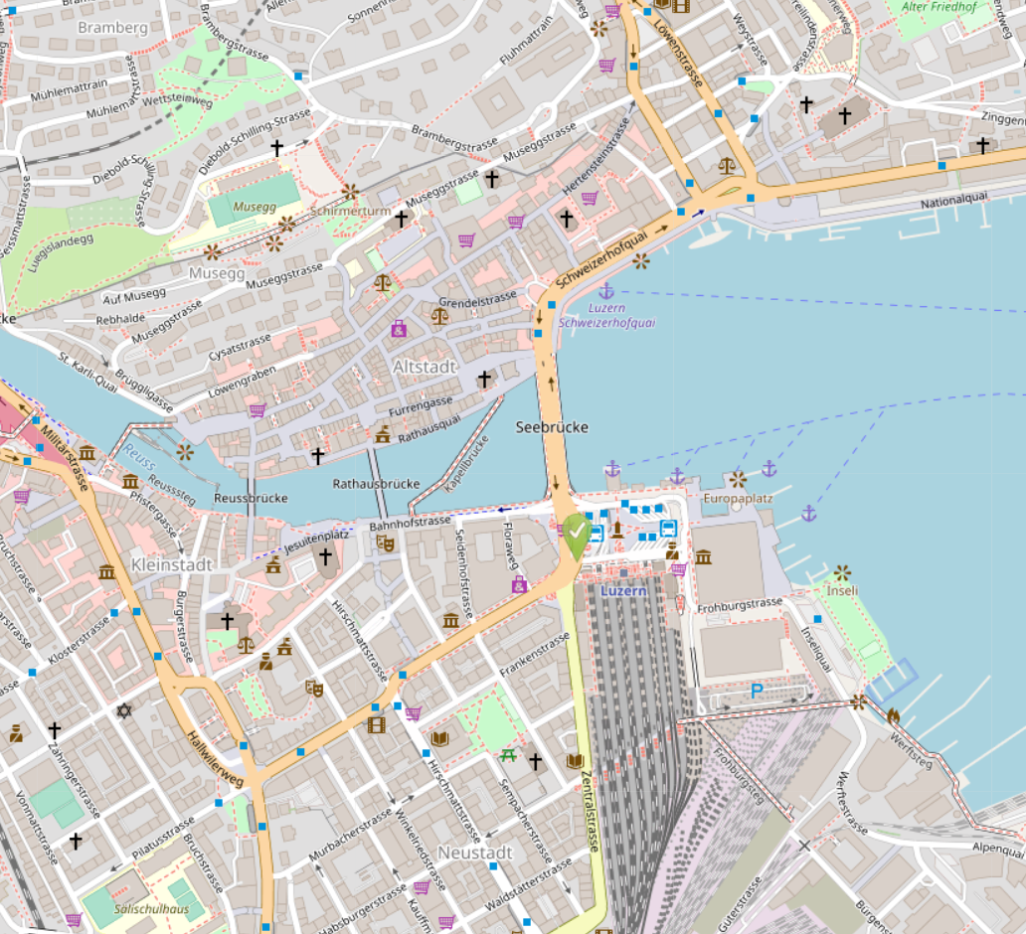
Tuesday Dinner
Kulturhof Hinter Musegg,
Diebold-Schilling-Strasse 13
AGM and Monday Dinner
Maskenliebhaber-Gesellschaft Stadt Luzern,
Süesswinkel 7
Sunday Welcome Reception
Mill’Feuille, Mühlenplatz 6
Wednesday boat departure
Lucerne Harbour, Gate 1
Monday train departure
Lucerne Station, track 14
Sunday ECR Workshop
Radisson Blue Hotel, Inseliquai 12B
Conference Venue
Lucerne School of Social Work, Inseliquai 12B

